Slide 1
coral dev board implementation FOR ANOMALY DETECTION [IN DNP3 SCADA SYSTEMS IN SMART GRIDS]
GROUP - 03
HARISH MANUKONDA – cb.sc.u4aie24115
JYOTHSNA . V – cb.sc.u4aie24117

Slide 2
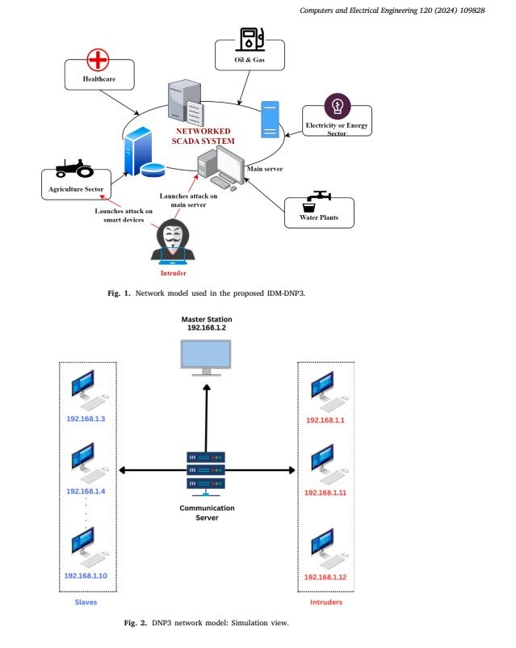
INTRODUCTION TO DNP3 IN SCADA
The DNP3, a widely adopted communication protocol in SCADA systems, facilitates real-time monitoring and control across critical infrastructure, like power grids, water systems, and energy management systems.
However, its inherent vulnerabilities to cyber threats, including unauthorized access and data manipulation, necessitates advanced security mechanisms.
This research aims to introduce an integrated approach combining Anomaly Detection for attack identification, with the Coral Dev Board to reduce latency, using DNP3 data flow in SCADA systems of smart grids.

Slide 3
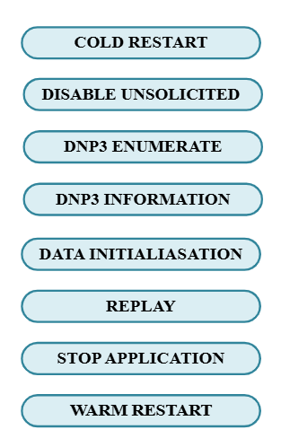
dataset overview
The DNP3 Parser dataset encompasses over 6,000 data flows, divided into 4,194 for training and 1,800 for testing, and features 102 attributes capturing traffic metadata, timing information, packet characteristics, and protocol behaviors.
The dataset consists of eight distinct attack types alongside a class representing normal, legitimate traffic. By simulating real-world challenges in intrusion detection, this balanced dataset highlights the pressing need to strengthen DNP3 against increasingly sophisticated and evolving cyber threats.

Slide 4
LITERATURE REVIEW
PAPER 1: AE-LSTM Based Anomaly Detection System for Communication Over DNP 3.0
ADVANTAGES:
High Accuracy & Efficiency – The AE-LSTM-based AI system detects DNP3 cyber threats with 99% accuracy, 98% TPR, and 1.6% FPR.
Enhanced EMS Security – The model strengthens power system resilience by detecting cyber threats in EMS and DNP3 vulnerabilities.
DISADVANTAGES:
Limited Generalization – Effective against known attacks but may struggle with zero-day threats and adversarial modifications.
High Complexity – Autoencoder-LSTM increases computational overhead, challenging real-time detection in large SCADA systems.
PAPER 2: An effective intrusion detection scheme for Distributed Network Protocol 3 (DNP3) applied in SCADA-enabled IoT applications
ADVANTAGES:
Multi-Class Classification – Classifies eight DNP3 attack types, improving threat differentiation and precision.
Optimized Features & Accuracy – Uses 99 features with XGBoost, Random Forest, and Decision Trees, achieving 99.56% accuracy in SCADA threat classification.
DISADVANTAGES:
Labeled Data Dependence – Limited effectiveness against novel cyber threats without prior training data.
Real-Time Constraints – Preprocessing and feature selection may introduce latency in SCADA monitoring.

Slide 5

PROPOSED INTRUSION DETECTION SYSTEM - 1
Anomaly detection refers to the identification of unusual patterns, anomalous events, or data points that deviate from expected behavior. In the proposed framework, all attack types are classified as a single, anomalous class, while the other, non-attack data is labeled as normal class.
To simulate a real-world environment, the dataset used in this study is subjected to manual data augmentation, generating 1,398 normal traffic data points. Furthermore, varying levels of intrusion, approximately 1%, 3%, 5%, and 7% of anomalous data are introduced relative to the normal traffic, effectively mimicking realistic data flow patterns.

Slide 6
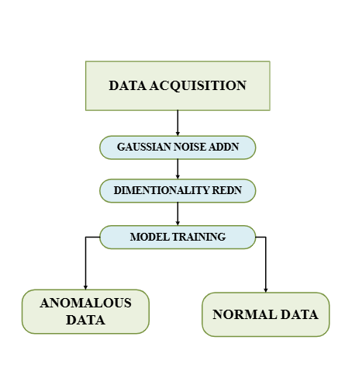
PROPOSED INTRUSION DETECTION SYSTEM -2
1) Gaussian Noise Injection: Gaussian noise is introduced into the dataset to simulate real-world perturbations and ensure that sensitive features are not overfitted by the model.
2) Dimensionality Reduction using Principal Component Analysis (PCA) is used for dimensionality reduction to project data into a lower-dimensional space and filter out less informative features while preserving the variance in the data.
3) Random Forest Classifier: Of all the Machine learning classifiers (like SVM, Decision trees, ANN, XGBoost, and Random forest) tried out for Anomaly detection for this dataset, Random Forest outperforms all others.

Slide 7
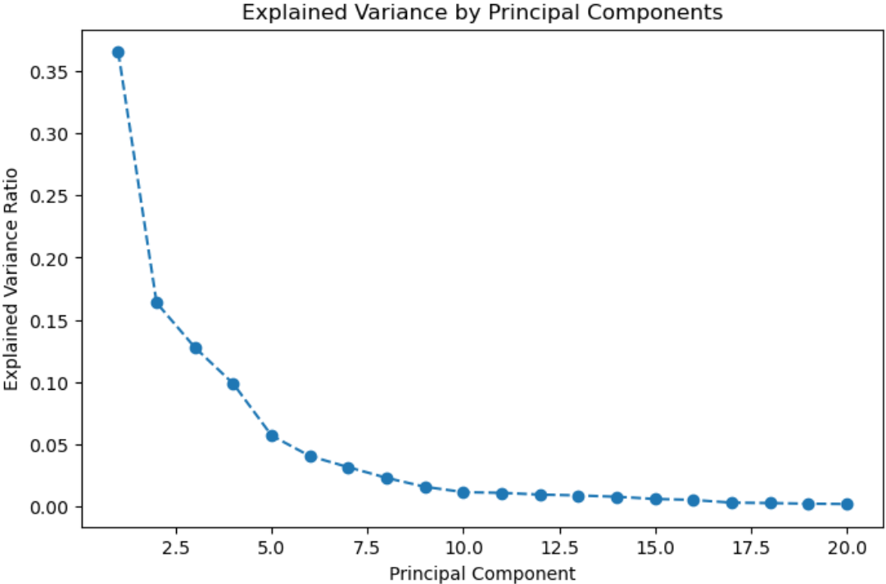
dimensionality reduction using PCA
Feature Scaling (Normalization):Ensures uniform feature scales using StandardScaler(), preventing dominance of large-value features and improving model efficiency.
Dimensionality Reduction (PCA): Reduces dimensions from 102 to 20 while preserving 90%+ variance, eliminating redundancy.
Outcome: Enhances training and inference speed while minimizing overfitting risk.

Slide 8
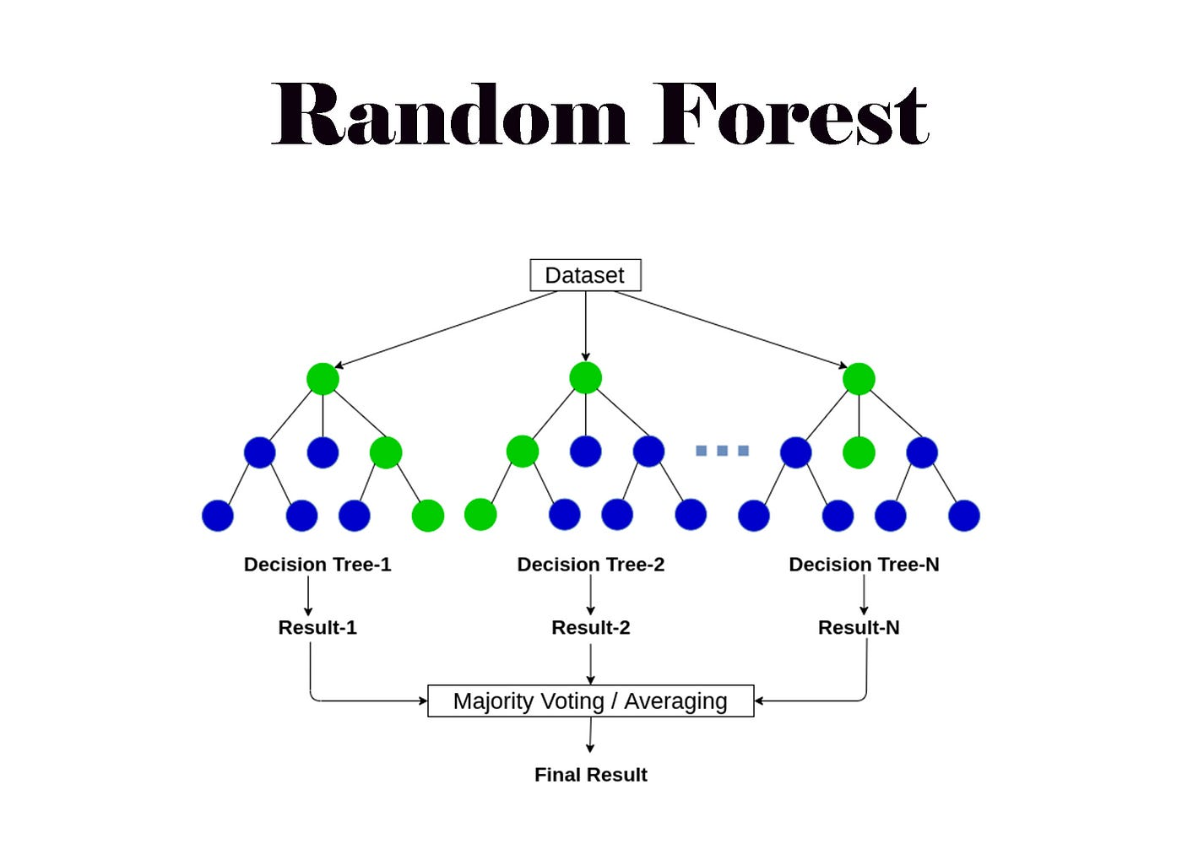
Random forest architecture
Random Forest (RF) is an ensemble learning algorithm that constructs multiple decision trees and combines their predictions to improve accuracy and reduce overfitting, which is widely used for classification and anomaly detection due to its robustness and efficiency.
This diversity is achieved through a technique called bagging (bootstrap aggregating). Bagging involves creating multiple random samples of the training data with replacement and training a separate decision tree on each sample.

Slide 9
SOFTWARE RESULTS
The Random Forest Classifier (RFC) was implemented for anomaly detection in DNP3-based SCADA systems. The model was evaluated at different intrusion rates (1%, 3%, 5%, 7%), showing high accuracy and perfect recall across all cases.
Intrusion Rate | Accuracy | Precision | Recall | F1 - Score
1% | 98.59% | 20.00% | 100% | 33.33%
3% | 99.65% | 90.91% | 100% | 95.24%
5% | 98.98% | 86.36% | 100% | 92.68%
7% | 98.66% | 82.61% | 100% | 90.48%
The Random Forest Classifier achieved a peak accuracy of 99.65% (3% intrusion rate) and maintained a perfect 100% recall across all cases, ensuring no anomalies were missed.

Slide 10

Challenges of Software-based RFCs
1. Bottlenecks in CPU/GPU-based Implementations
Traditional implementations using Python’s Scikit-Learn rely on CPUs/GPUs, as dataset size and tree complexity increase, such execution suffers from memory bottlenecks and inefficient branching operations.
2. Latency Issues with Deep Decision Trees
Inference latency rises with deeper trees as each input navigates multiple branches. More memory accesses and evaluations slow decision-making on traditional hardware.
3. Efficient Edge Inference with Coral Dev Boards
Coral Dev Boards leverage TPUs for low-power, high-speed inference, reducing memory bottlenecks and latency compared to CPU/GPU-based implementations.

Slide 11
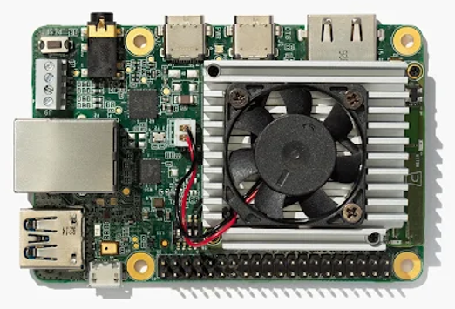
What is a coral dev board?
One can think of the Coral Dev Board as a tiny supercomputer built for smart, on-the-go AI tasks. Developed by Google, it's designed to run machine learning models right where the action is — at the edge — like in your IoT devices, smart cameras, or even robots.
Why is it special?
Because it has a built-in AI brain: the Edge TPU. It’s a custom chip that’s like a turbocharger for AI — it runs TensorFlow Lite models blazingly fast without eating up tons of power.
🔹 Key Components: 1. Quad-core Cortex-A53 CPU 2. 1GB LPDDR4 RAM 3. Google Edge TPU (for AI acceleration) 4. Wi-Fi, Bluetooth, USB, and GPIO for connectivity

Slide 12

WHY CORAL DEV BOARD?
Real-Time Performance: Low-latency inference with Edge TPU.
Energy Efficient: Ideal for remote, low-power environments.
Data Security: On-device processing ensures privacy.
Compact & Portable: Easy deployment in SCADA systems.
Cost-Effective: Reduces operational costs.
AI Optimized: Accelerates TensorFlow Lite models.
Seamless Integration: Versatile I/O for SCADA connectivity.
Cloud Independence: Reliable without internet reliance.

Slide 13
FUTURE APPLICATIONS OF THE CORAL DEV BOARD
Enhanced Predictive Maintenance:
Using the board to analyze DNP3 communication patterns and detect subtle anomalies that indicate potential equipment failures, enabling proactive maintenance and reducing downtime in industrial systems.
Autonomous SCADA System Optimization:
Integrating the board to enable self-healing SCADA systems that automatically respond to detected anomalies, optimize network performance, and ensure uninterrupted operations without human intervention.

Slide 14
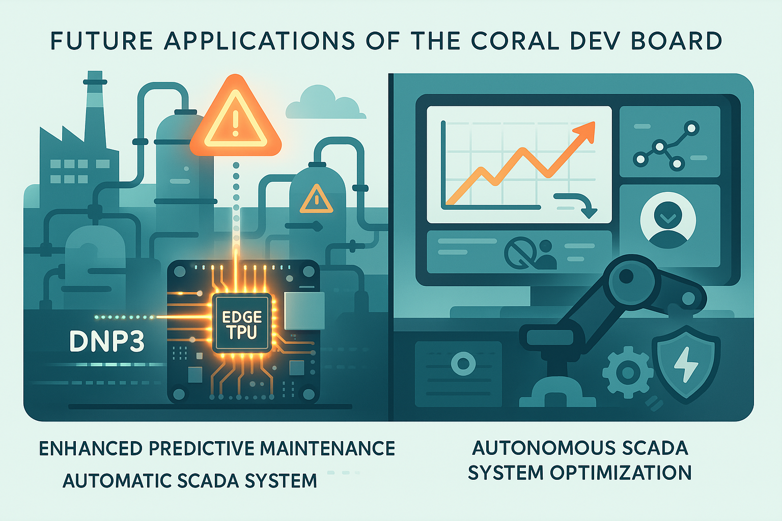
FUTURE ENHANCEMENTS
Unsupervised Learning: Explore unsupervised anomaly detection methods to identify zero-day attacks and novel threats.
Expanded Dataset: Incorporate additional SCADA protocols like Modbus and IEC-104 to improve generalization across systems.
Hybrid Edge-Cloud Architecture: Combine Coral Dev Board's edge capabilities with cloud computing for scalable and efficient anomaly detection.
Real-Time Adaptation: Implement adaptive learning techniques to update the model dynamically with new attack patterns.
Energy Optimization: Develop solutions to further reduce the power consumption of edge devices during continuous operation.

Slide 15
CONCLUSION
This project successfully implemented a Random Forest-based anomaly detection system for DNP3 SCADA systems, utilizing PCA for dimensionality reduction and deploying the model on the Coral Dev Board for efficient edge-based inference. The system demonstrated high accuracy and recall across varying intrusion rates, showcasing its robustness in real-world scenarios.
By integrating machine learning with edge computing, the project provides a scalable solution to enhance the security and reliability of critical infrastructure systems. The Coral Dev Board enabled real-time anomaly detection, making it ideal for SCADA environments requiring low latency and high efficiency.
The project sets the stage for further advancements, including unsupervised learning for zero-day attack detection, expanding datasets to include additional SCADA protocols, and developing hybrid edge-cloud architectures for adaptive anomaly detection systems. These enhancements aim to strengthen industrial network security and resilience.

Slide 16

Thank you

